Slide 1
How many people are going to read Trump’s next post?
Group Member:
3035123655 Choi jae won
3035467752 Lai Pak Hei Syrus
3035381104 Lam Tsun Ho Kevin
3035164283 Park chan ho

Slide 2
1.
Introduction

Slide 3
Background
SNSs such as Facebook and Twitter allow people to spread ideas much faster and efficiently
But we are not yet certain of what factor(s) of SNS allows ideas to be spread fastest

Slide 4
How is it related to complex systems?
No central control
Determined by a few basic rules and initial conditions
~ similar to the germ model

Slide 5
Context
Applying it to real-life situations that are relevant to us
The subject in our simulation model: Donald Trump’s Twitter posts
Studying its spread among the population in the framework of the complexity theory

Slide 6
Complex contagions
Like the spreading of virus but the spread of information instead
Affected by social reinforcement and homophily

Slide 7
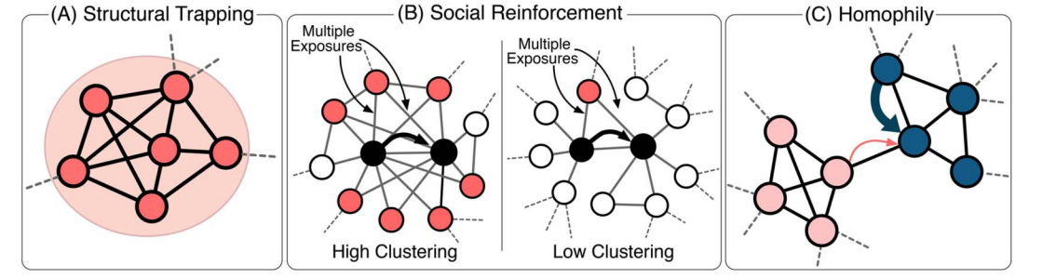
Complex contagions

Slide 8
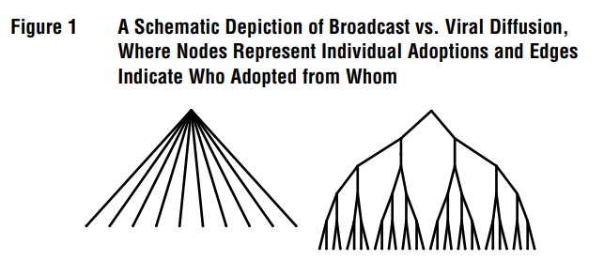
Broadcast v.s. Viral Post

Slide 9
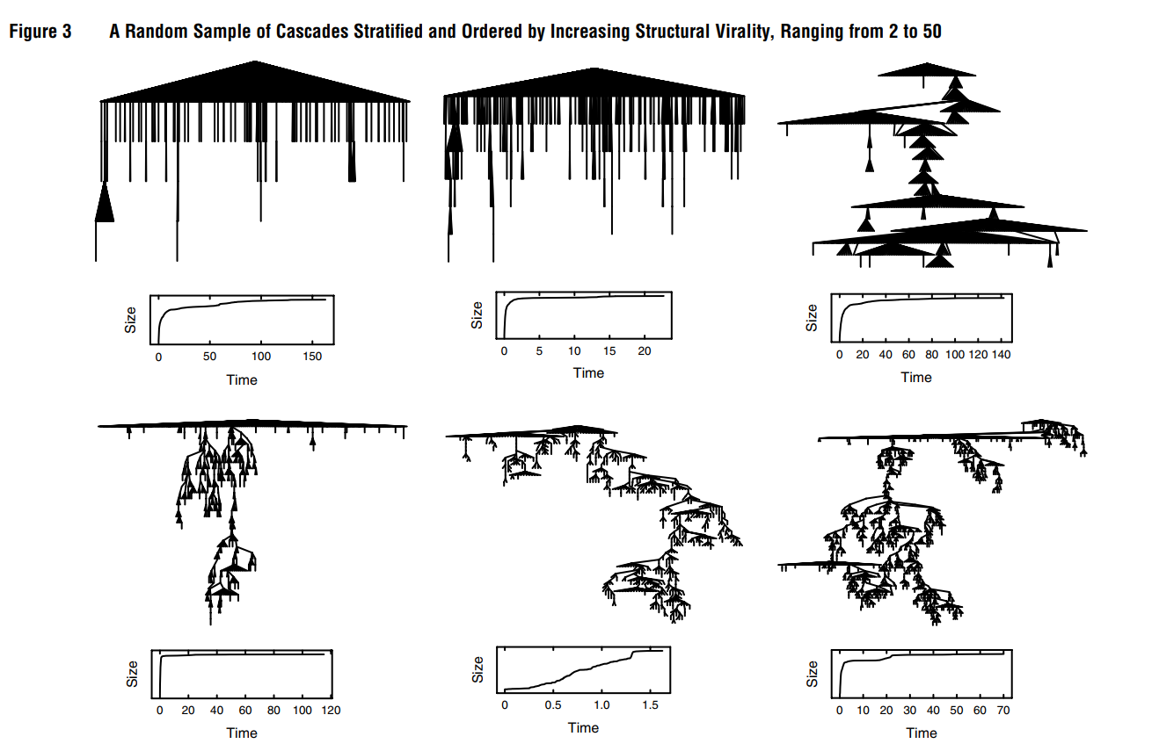
Diffusion trees

Slide 10
Broadcast v.s. Viral Post

Slide 11
2.
Simulation

Slide 12
The basic assumptions of our system
An individual may or may not share a post
Everyone has an equal number of friends
You will see the post if any of your friends has shared it
Only one post is being shared

Slide 13
Initial Inputs
Initial number of people reading Trump’s post
Number of friends that each person has
Probability that an individual will share it
Total number of people in the system

Slide 14
Expected outcomes
Total number of people that Trump’s post reaches (and the proportion of the population)
Finding out the factor which affects the outcome most.

Slide 15
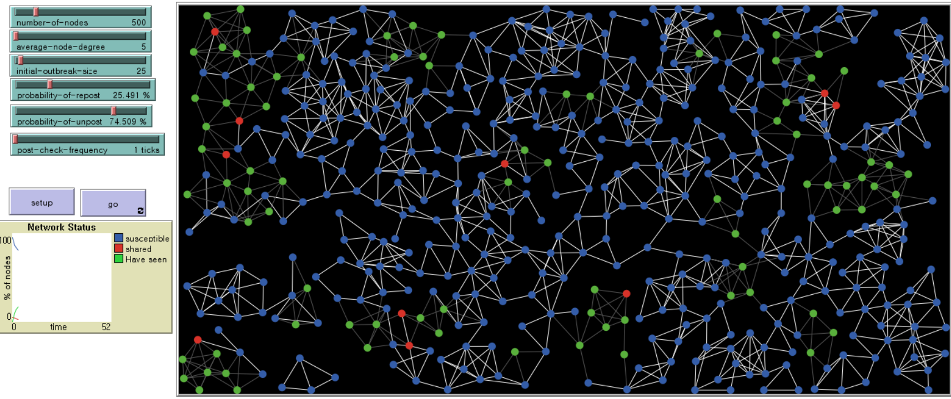
Shared: a person who has shared the post
Have seen: a person who already decided not to share OR who already shared the post
Susceptible: a person who has not seen the post

Slide 16
The flow of our model
At the beginning, people who have initially shared the post are red in colour.
The neighbor nodes (friends) will see it.
They can choose to share the post or not.
Node that initially shared the post will turn into green because node already made the decision.
Iterate until no more post is shared.

Slide 17
The default constants
Number of Node = 500
Average Node Degree = 1%
Initial outbreak size = 5%
Probability of repost = 30%
Probability of not post = 70% (1 - probability of repost)

Slide 18
Results
Number of green nodes at the end
=the total number of people who have
seen the post.
See how the output changes with different initial conditions.

Slide 19
3.
Conclusion

Slide 20
Outcomes
The average node degree, the initial outbreak size, and the probability of sharing
--->all positively proportional to the result
The size of the population
--->no significant effect; only random fluctuations

Slide 21
Average node degree | Trial 1 | Trial 2 | Trial 3
3% | 12.8% | 12.4% | 11.2%
5% | 17% | 18.4% | 16.2%
7% | 22.6% | 21.4% | 18.4%
Initial outbreak size | Trial 1 | Trial 2 | Trial 3
5% | 18.6% | 19.4% | 20.6%
7% | 20% | 24.8% | 21.4%
9% | 29.6% | 27.2% | 27%

Slide 22
Probability of repost | Trial 1 | Trial 2 | Trial 3
15% | 8.6% | 8.2% | 10.2%
25% | 25.8% | 22.6% | 25.2%
35% | 25.8% | 22.6% | 25.2%
Number of node | Trial 1 | Trial 2 | Trial 3
500 | 17.1% | 17% | 15%
1000 | 15.8% | 16.6% | 16.2%
2000 | 15.9% | 15.7% | 16%

Slide 23
How many people will see Trump’s next post?
Total no of his followers: 43.4M
Average no of retweets on a random day: 21.375K
Average % of retweets=43.4M/21.375K=0.04925%
1) as of 27 Nov 2017
2) on 22 Nov 2017, he had 8 tweets in total, with their respective no of retweets being 33K, 39K, 25K, 16K, 11K, 11K, 26K, and 10K

Slide 24
Limitations
The population is assumed to be 500
---> there are millions of Twitter users
Everybody has the same no. of friends.
---> the real network is a small-world one
↓ in the probability of sharing posts
---> may not correspond to the real-world value

Slide 25
Reference
The Structural Virality of Online Diffusion (Sharad Goel, Ashton Anderson, Jake Hofman, Duncan J. Watts)
Virality Prediction and Community Structure in Social Networks (Lilian Weng, Filippo Menczer & Yong-Yeol Ahn)

Slide 26
THANKS!
Any questions?

